Slide 1
ORGANIZED CRIME IN Technology
Michael Amoo
CSC 120 34

Slide 2
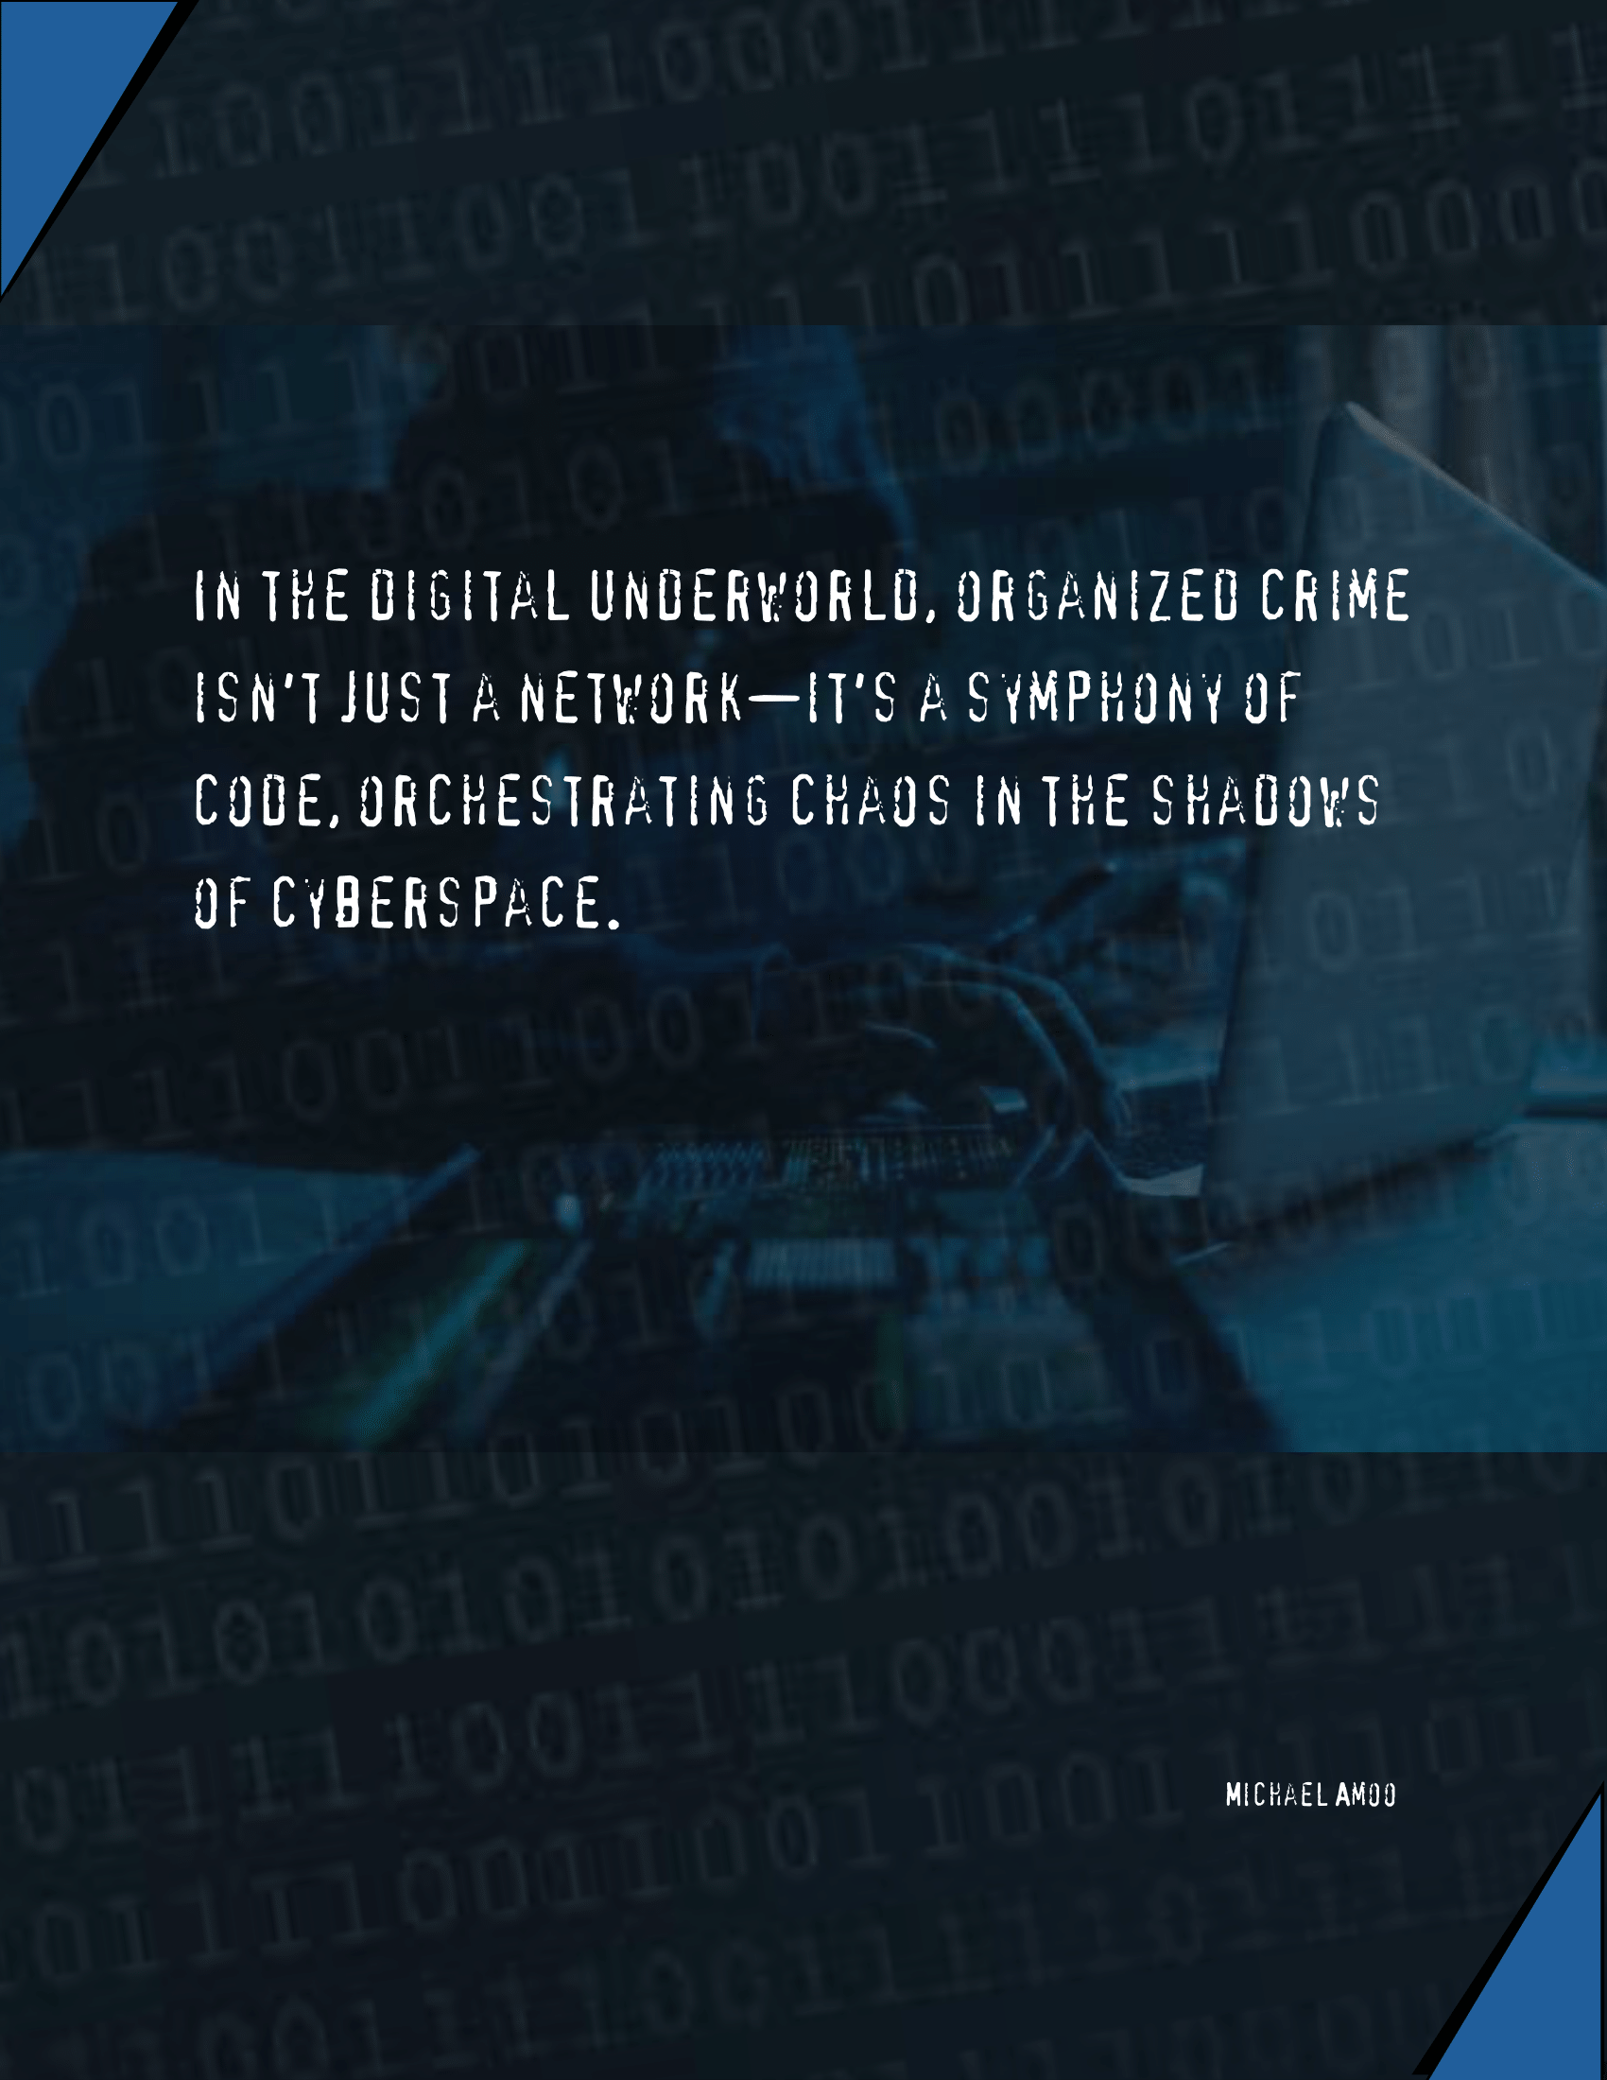
What is organized Crime?
Organized crime, once traditional like robing the bank and other illegal activities, has evolved alongside technology, now engaging in sophisticated cybercrimes. This transition involves coordinated criminal activities aimed at financial gain or influence. With technological advancements, criminal enterprises now conduct cybercrimes like hacking and phishing. Understanding this evolution is vital to addressing the modern challenges to cybersecurity and society.

Slide 3

Events that dealt with organized Crime
Cases like the WannaCry in May 2017 ransomware attack and the Carbanak cyber bank heist that happened in December 2023 demonstrate the disruptive power and widespread consequences of cybercrimes. These events underscore the vulnerabilities of digital infrastructure and emphasize the urgency of enhancing cybersecurity measures to address emerging threats.

Slide 4
DATA

Slide 5
How do you protect yourself?
Keep your software and operating systems updated to patch known vulnerabilities.
Use strong, unique passwords for each online account and consider using a password manager.
Be cautious of suspicious emails, links, and attachments, and verify the sender's identity before clicking on anything.
Enable multi-factor authentication wherever possible to add an extra layer of security.
Regularly back up your important data to an external hard drive or a cloud storage service.

Slide 6

Thank You!
Word Excel

Slide 7
Works cited
Federal Bureau of Investigation. Business Email Compromise - FBI. 21 December 2023. FBI. Website. 10 April 2024. <https://www.fbi.gov/how-we-can-help-you/scams-and-safety/common-scams-and-crimes/business-email-compromise>.
Telegraph Media Group. Sony PlayStation Hack: statement in full. 27 April 2011. The Telegraph. Website. 10 4 2024. <https://www.telegraph.co.uk/technology/sony/8476152/Sony-PlayStation-Hack-statement-in-full.html>.
United Nations Office on Drugs and Crime. Criminal groups engaging in cyber organized crime. 15 June 2019. Website. 11 April 2024. <https://www.unodc.org/e4j/zh/cybercrime/module-13/key-issues/criminal-groups-engaging-in-cyber-organized-crime.html#:~:text=Cyber%20organized%20crime%20can%20include,typically%20associated%20with%20organized%20crime.>.

